Slide 1
CSC 430 Database Management System Project
Michael Towns
Chris
Sanders

Slide 2
Area of Application
Primary Purpose:
This database and management system allows a user to see what insurance agencies are accepted at a given medical institution, as well as the location and operating hours of the institution.
Secondary Purpose:
The user will be able to see a list of medical practitioners that work in a certain institution.
The user will also be able to rate and review a medical institution and/or a medical practitioner.
Notes:
Steven
Multiple optometrists
STAKEHOLDERS!!!!!!!!!!!

Slide 3
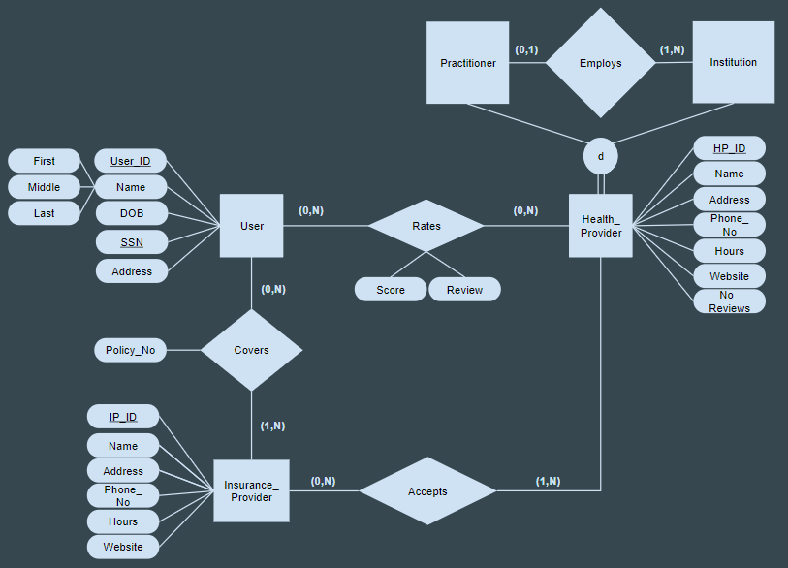
Old Entity/Relationship Model
Notes:
Chris

Slide 4
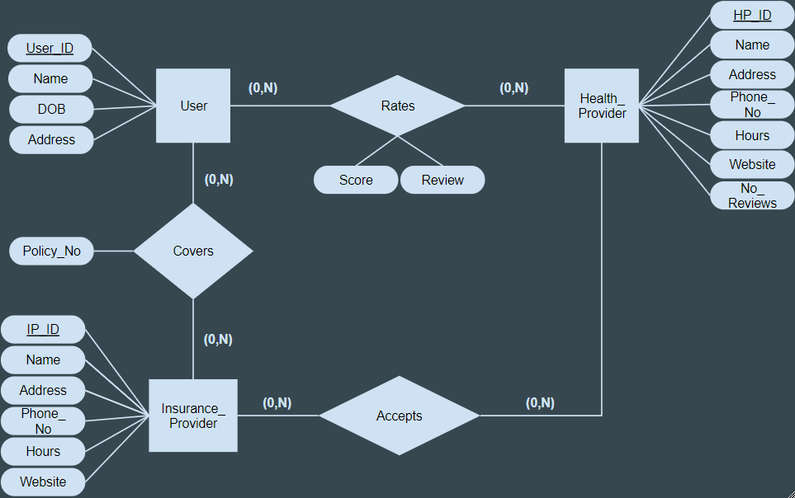
New Entity/Relationship Model
Notes:
Chris
Must explain choice to remove subclasses, SSN, and what the id’s are, and changed constraints

Slide 5
Constraints
A User can be Covered by more than one Insurance Provider or none, and
An Insurance Provider can cover many Users or none
A Health Provider can accept many Insurance Provider or none,
An Insurance Provider can be accepted by many Health Providers or by none
A User can rate many Health Providers or none, and
A Health Provider can be rated by many Users or by none
Notes:
Made all 0,N because it would be a stumbling block otherwise for account creation.

Slide 6
Constraints
If an entry is deleted from an entity, it all entries with that entity will be delete from the relationship tables
If any entries are deleted, a copy of the deleted row will be added to a backup table
A User must be at least 18 years old
If a relationship is created where one of the entities does not exist, a entity will be generated with available information
Notes:
Made all 0,N because it would be a stumbling block otherwise for account creation.

Slide 7
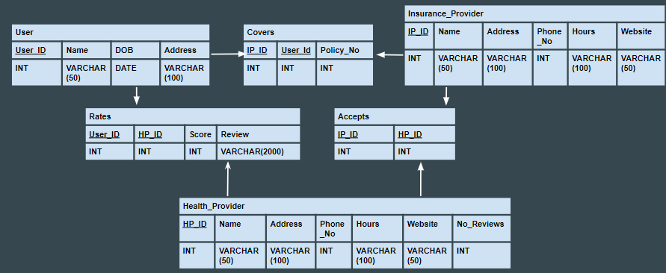
Conceptual Schema with Data Constraints
Notes:
Steven

Slide 8
Triggers (examples)
Chain Delete (User)
CREATE TRIGGER User_Delete
BEFORE DELETE ON User
FOR EACH ROW
BEGIN
DELETE FROM Rates WHERE Rates.uid = OLD.uid;
DELETE FROM Covers WHERE Covers.uid = OLD.uid;
END
Backup (User)
CREATE TRIGGER User_Backup
BEFORE DELETE ON User
FOR EACH ROW
BEGIN
INSERT INTO UserBackup VALUES(OLD.uid, OLD.name, OLD.dob, OLD.address, Now());
END
Notes:
Steven

Slide 9
Triggers (examples)
User Age Check
CREATE TRIGGER Age_Check
BEFORE INSERT ON User
FOR EACH ROW
BEGIN
DECLARE msg varchar(255);
IF ((DateDiff(Now(),dob)/365) < 18) THEN
SET msg = 'Invalid Date of Birth';
SIGNAL sqlstate '45000' set message_text = msg;
END IF;
END
Stub Entries (User)
CREATE TRIGGER Stub_Creation
BEFORE INSERT ON Rates
FOR EACH ROW
BEGIN
IF NOT EXISTS(SELECT * FROM User WHERE uid=NEW.uid) THEN
INSERT INTO User VALUES(NEW.uid);
END IF;
END
Notes:
Steven

Slide 10
Normalization - 2nd Normal Form
Health_Provider:
HP_ID ->
Name
Address
Address ->
Phone_No
Hours
Website
Name -> No_Reviews
Insurance Provider:
IP_ID ->
Name
Address
Address ->
Phone_No
Hours
Website
User:
User_ID ->
Name
Address
Name -> DOB
Notes:
Steven

Slide 11
CSC 430 Database Management System Project
Michael Towns
Chris
Sanders

